Slide 1
Leading the way to housing in surrey

Slide 2
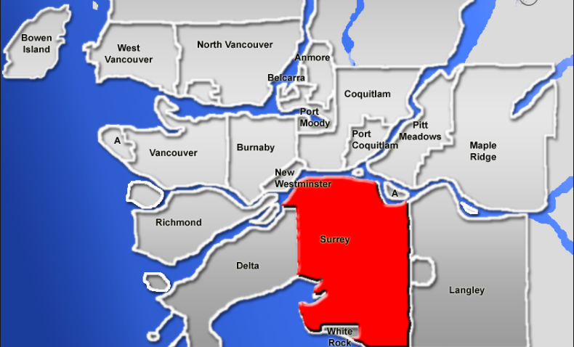
Surrey Landscape
Currently the 3rd largest city by area in BC ,
Second largest city in population: 517,877
A growth rate outpacing the national average
A population
of 800,000
Expected
by 2045

Slide 3
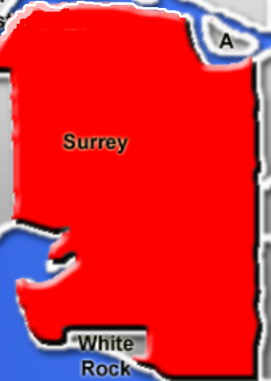
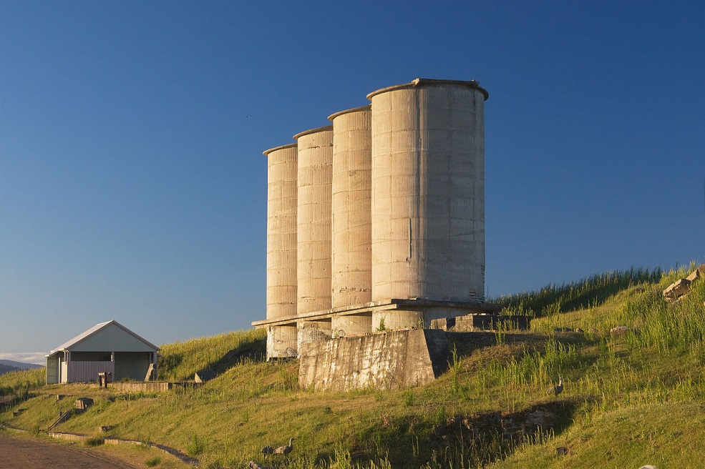
In the past
SHHTF
HOMELESS COUNTS
OLYMPICS

Slide 4
Opportunity
HPS:
housing first

Slide 5
4 Agencies
Surrey Housing First Collaborative

Slide 6
starting out

Slide 7
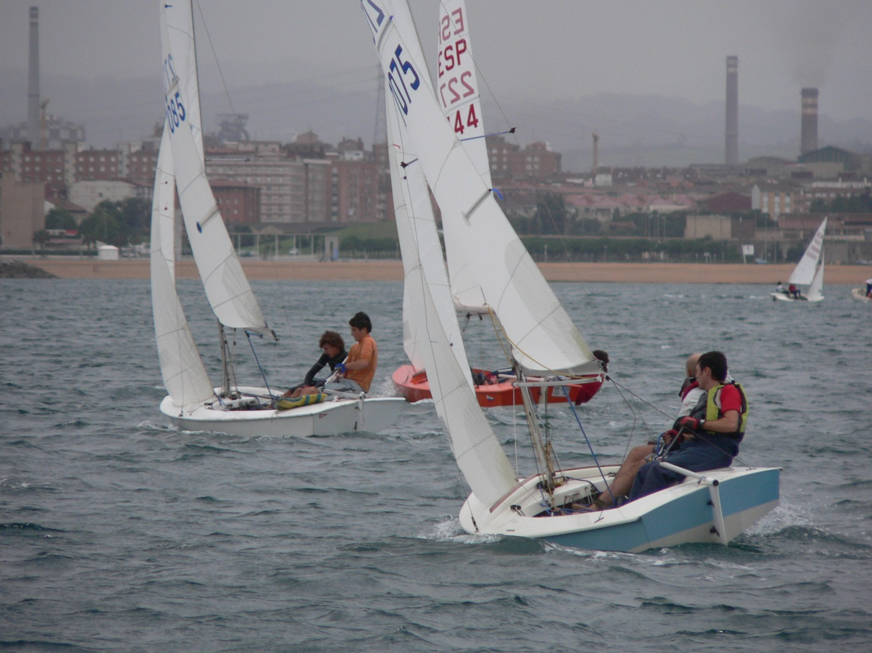
Working Together

Slide 8
Challenges Remain
HOUSING, HOUSING, HOUSING
RENTAL RATES
HEALTH CONCERNS & OVERDOSES

Slide 9
Our shared Success
Since 2014 Over 250 People Housed
4 Teams Work Collaboratively & Share Resources
Improved
Wellness
for Our
Clients

Slide 10
Client success
“SO MUCH HAPPIER”
“I was homeless and they got me into the shelter
then helped me get into housing.
They were very caring and helped me a lot.
I was hungry and in bad condition I didn’t know what to do with my life.
I was lucky to meet the staff from that day my life started to be better.
I started to feel more safety they were very friendly and very helpful.”

Slide 11
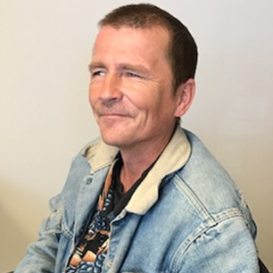
ongoing success
Tommy, 46, “I’ve lived in Whalley all my life”,
“Pretty much lived on basement floors and the bush all my life”
“You guys have done everything I couldn’t dream about”,
“Before it was bad. Now I can actually sleep at night”,
“The landlord told me I could
be there for 20 years if I want.”
HOUSED:
SINCE MARCH 2016

Slide 12
Where TO now?

