Slide 1
Home Front A Regional Collaborative Approach to Homelessness in Metro Vancouver
October 2017
Notes:
Home Front will be an innovative Metro Vancouver-wide partnership to implement a collective approach to homelessness in Metro Vancouver
Our goal is not to end homelessness as we don’t believe that is practical, but to make it “rare, brief and one-time”

Slide 2
Homelessness - A Regional Issue
Municipalities are working in isolation from each other
Needs of vulnerable populations cross municipal boundaries
Information exchange, data sharing and collaboration is limited
No regional plan with a coordinated set of priorities and actions
Notes:
Although homelessness is a regional issue, each municipality in Metro Vancouver struggles on their own
And it is difficult to obtain a clear picture of the needs of a diverse homeless population and the efficacy of initiatives
Yet - there is no regional plan with a coordinated set of priorities and actions that will make the best use of available resources.

Slide 3
Home Front - Founders
Representatives from:
BC Housing
BC Non-Profit Housing Association
City of Surrey
City of Vancouver
Council of Community Homelessness Tables
Fraser Health Authority
Greater Vancouver Shelter Strategy
Lu’Ma Native Housing Society
MCFD
Service Canada (ex officio)
SPARC BC
Vancity Community Foundation
Vancouver Coastal Health Authority
Notes:
Initiative started with a rump of the former Regional Steering Committee on Homelessness - expanded following a leadership summit in March 2016

Slide 4
Home Front - Goal
Rare - Fewer people are homeless
Brief - People are homeless for fewer days
One-time - Fewer people return to homelessness
Notes:
Our goals are simple and easily understood:
Fewer people are homeless
People who become homeless are homeless for fewer days
Fewer people return to homelessness

Slide 5
Home Front - Principles
Shared goals
Common measurement
Continuous communication
Shared learning
Mutually reinforcing actions
Engage the entire community
Notes:
Home Front is based on the principles of Collective Impact – an approach to solving a social problem using a structured form of collaboration

Slide 6
Home Front - Features
Data-driven planning and decision making
Coordinated access to housing
Enhanced coordination of funding
Shared communication strategy
Determination of additional resources required
Notes:
Features will include:
Planning based on evidence
Provision of housing and services based on need
Shared objectives for funding
Energizing and engaging the public
Determination of the additional resources required to make homelessness in Metro Vancouver rare, brief and one-time

Slide 7
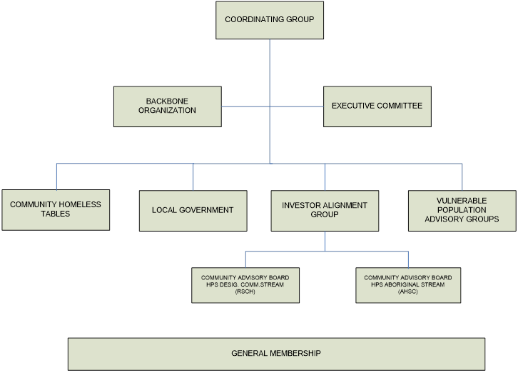
Home Front – Components
Notes:
Intent is to have a governance structure that represents and is responsive to all stakeholder constituencies in Metro Vancouver
The backbone organization is a separate contracted entity with staff and a specific set of skills to support and coordinate Home Front

Slide 8
Home Front - Status
BCNPHA selected as backbone organization
Next steps
Develop implementation road map
Engage stakeholders and build membership
Develop org structure
Establish performance data sources and dashboard
Establish mutually reinforcing actions to make homelessness in Metro Vancouver rare, brief and one-time
Notes:
BCNPHA has recently been selected as backbone organization
Next steps:
Developing a road map
Building the membership
Developing org structure
Establishing performance data sources and a dashboard
Establishing mutually reinforcing actions to make homelessness in Metro Vancouver rare, brief and one-time

